Slide 1
Chapter 8. Model Diagnostics
8.1 Residual Analysis
8.2 Overfitting and Parameter Redundancy

Slide 2
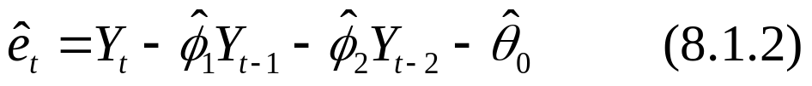
8.1 Residual Analysis
Consider an AR(2) model with a constant term:
Having estimated φ₁, φ₂, and θ₀, the residuals are defined as
For general ARMA models containing moving average terms, we use the inverted, infinite autoregressive form of the model to define residuals.

Slide 3
8.1 Residual Analysis
For simplicity, assume θ₀ = 0, from Eq. (4.5.4), we have
so that the residuals are defined as
Here π’s cannot be estimated directly but rather implicitly as a function of the estimate of φ’s and θ’s.

Slide 4
8.1 Residual Analysis
In Chapter 9, we know that
is the best forecast of Y_{t} based on Y_{t – 1}, Y_{t – 2}, Y_{t – 3}, … . The Eq. (8.1.3) can be rewritten as
residual = actual – predicted
is direct analogy with regression models.

Slide 5
8.1 Residual Analysis
If the model is correctly specified and the parameter estimates are reasonably close to the true values, then the residuals
should have nearly the properties of white noise.
should behave roughly like i.i.d. normal random variables with zero means and common standard deviations.

Slide 6
8.1 Residual Analysis
Plot of the Residuals
If the model is adequate, we expect the plot to suggest a rectangular scatter around a zero horizontal level with no trends whatsoever.
Canadian Hare Abundance Series
Following the discussion in Exhibit 7.8, the estimated model with φ₂ = 0 is

Slide 7
8.1 Residual Analysis
Observation:
In Exhibit 8.2, we see possible reduced variation in the middle of the series and increased variation near the end of the series – not exactly an ideal plot of residuals.

Slide 8
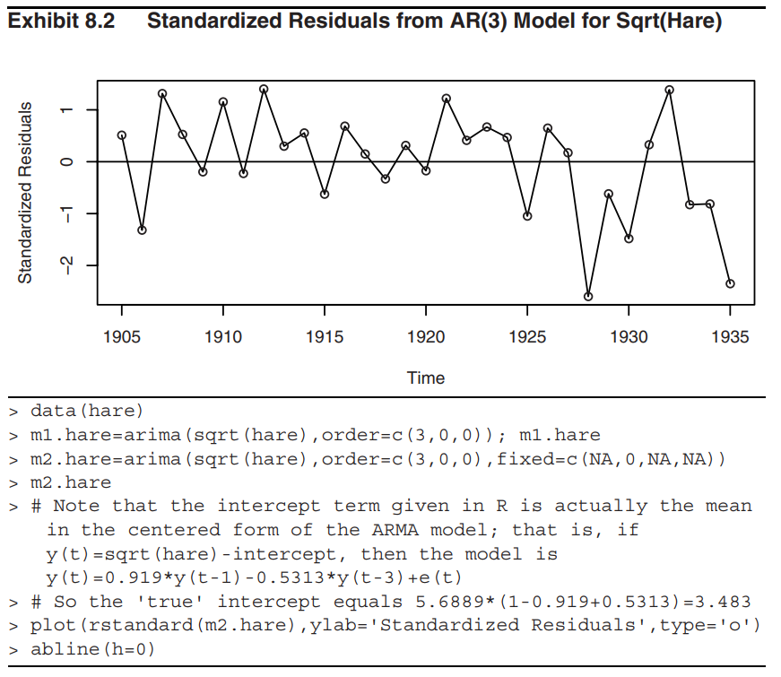
8.1 Residual Analysis

Slide 9
8.1 Residual Analysis
Oil Price Time Series
Use the result in Exhibit 7.9, the IMA(1, 1) model was fitted using the maximum likelihood estimation.
Observation:
In Exhibit 8.3, there are at least two or three residuals early in the series with magnitudes larger than 3 – very unusual in a standard normal distribution. Ideally, we need to go back to those months and try to learn what factors may cause such unusual fluctuation.

Slide 10
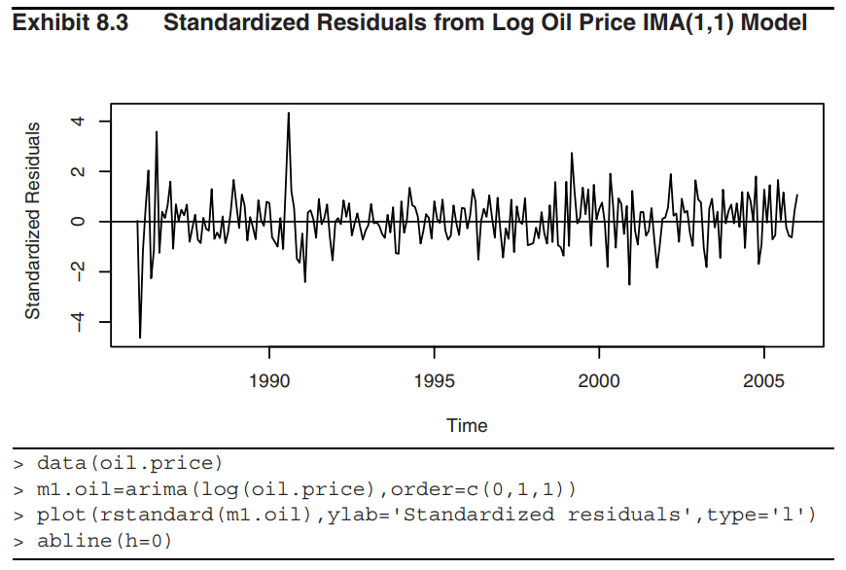
8.1 Residual Analysis

Slide 11
8.1 Residual Analysis
Normality of the Residuals
Quantile-quantile (QQ) plots are an effective tool for assessing normality.
Canadian Hare Abundance Series
In Exhibit 8.5, the extreme values look suspect. However, the sample is small (n = 31) and Bonferroni criteria for outliers do not indicate cause for alarm.

Slide 12
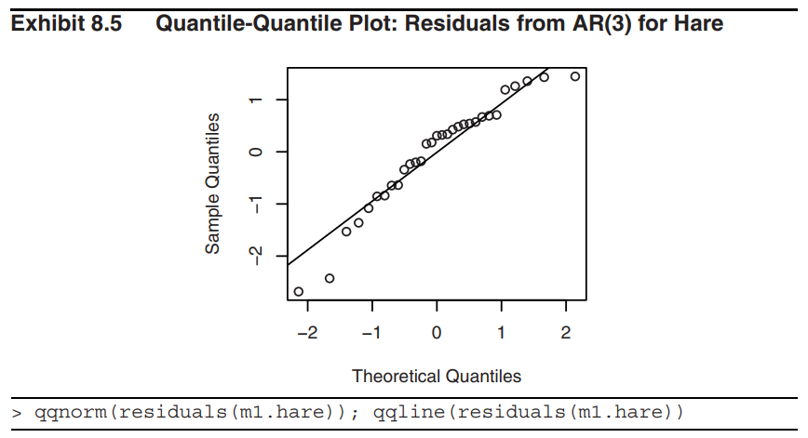
8.1 Residual Analysis

Slide 13
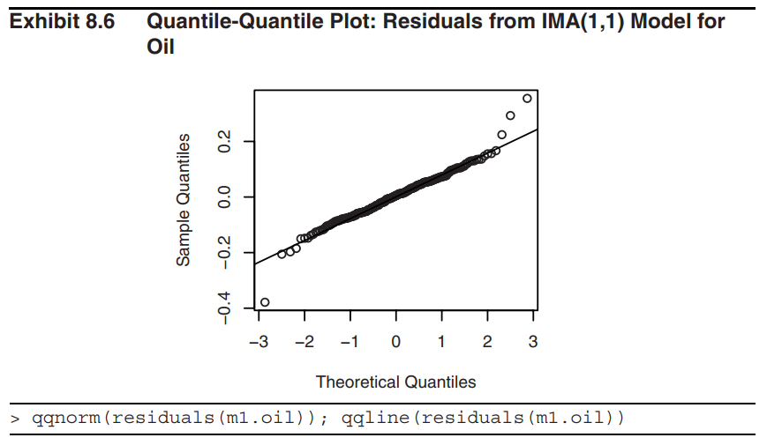
8.1 Residual Analysis
Oil Price Series
Exhibit 8.6 shows the outliers are quite prominent.

Slide 14

8.1 Residual Analysis
Autocorrelation of the Residuals
To check on the independence of the noise terms in the model, we consider the sample autocorrelation function of the residuals, denoted .
AR(1) Model
Consider a correctly specified and efficiently estimated AR(1) model. It can be shown that, for large n,

Slide 15
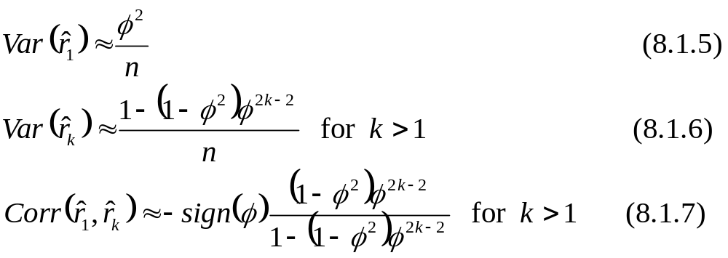
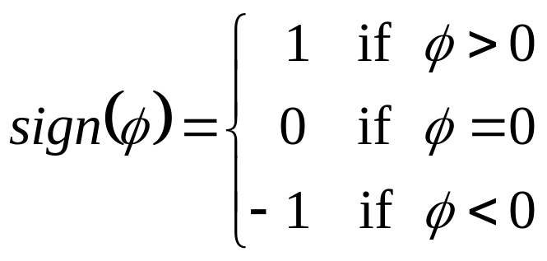
8.1 Residual Analysis
where

Slide 16
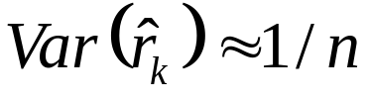
8.1 Residual Analysis
Exhibit 8.7 shows that is a reasonable approximation for k ≥ 2 over a wide range of φ-values.

Slide 17
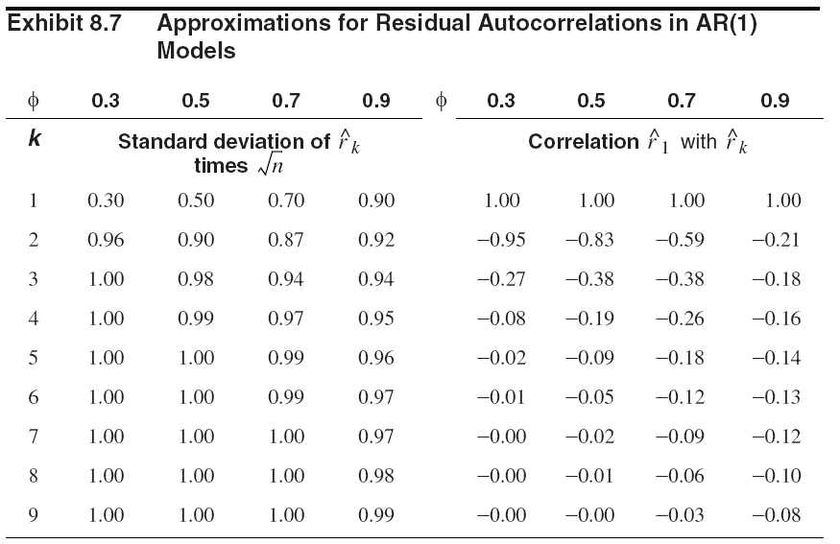
8.1 Residual Analysis

Slide 18
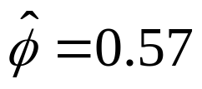
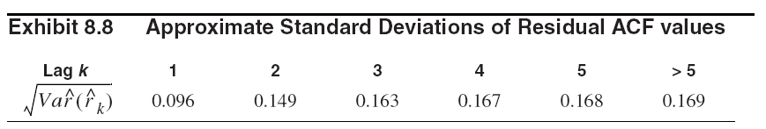
8.1 Residual Analysis
Consider a fitted AR(1) model with and n = 35, we have
Exhibit 8.9 shows no evidence of autocorrelation in the residuals of this model.
Remark: The dashed horizontal lines plotted are based on the large lag standard error of ±2/√n.

Slide 19
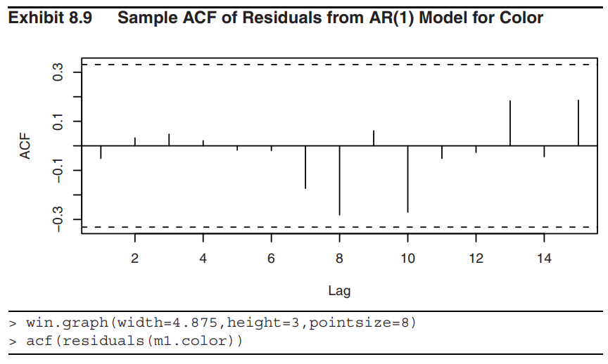
8.1 Residual Analysis

Slide 20
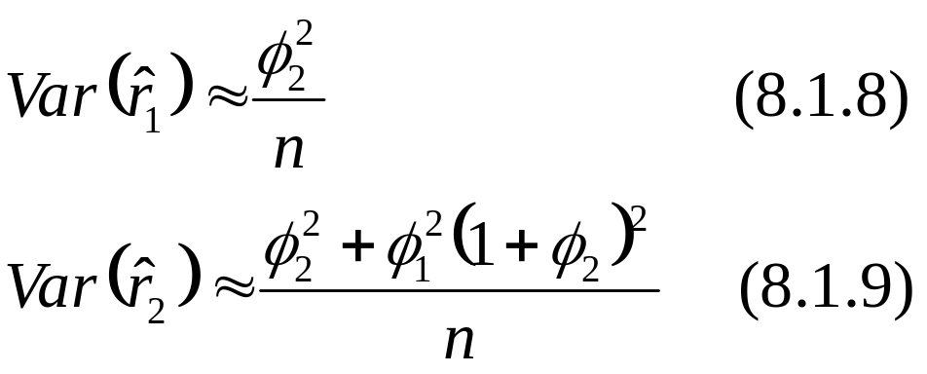
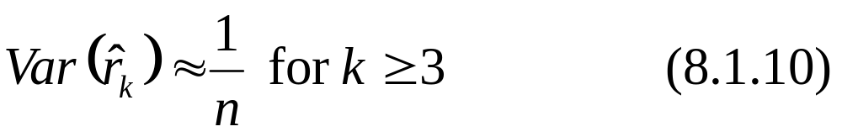
8.1 Residual Analysis
AR(2) Model
It can be shown that
If the AR(2) parameters are not too close to the stationarity boundary, then

Slide 21
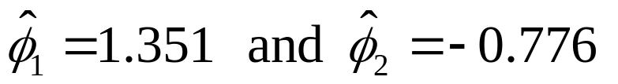
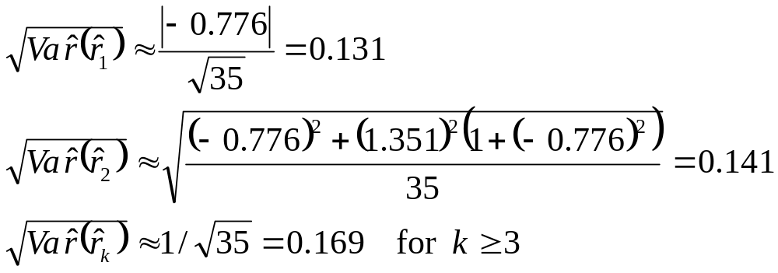
8.1 Residual Analysis
Consider an AR(2) model for the square root of the hare abundance series which is fitted by the maximum likelihood, we find that
Thus, we have, for n = 35,

Slide 22
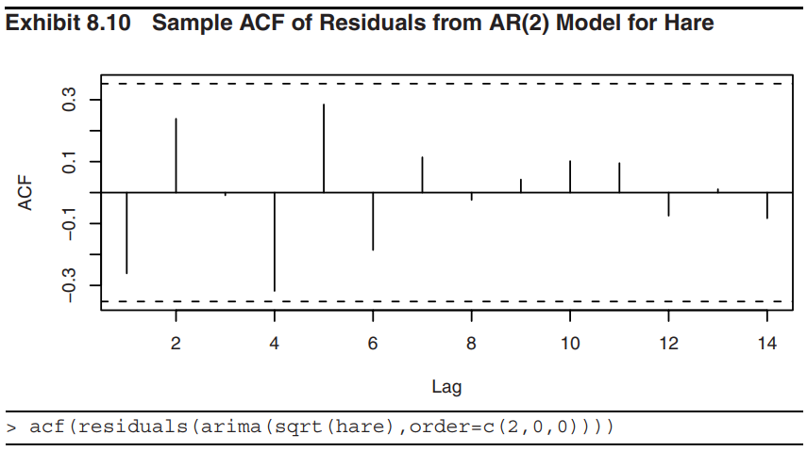
8.1 Residual Analysis
Exhibit 8.10 does not show statistically significant evidence of nonzero autocorrelation in the residuals.

Slide 23
8.1 Residual Analysis
The Ljung-Box Test
In addition to looking at residual correlation at individual lags, it is useful to have a test that takes into account their magnitudes as a group. It is possible that most of the residual autocorrelations are moderate, some even close to their critical values, but, taken together, they seem excessive.
Box and Pierce (1970) proposed the statistic
to address this possibility.

Slide 24
8.1 Residual Analysis
If the correct ARMA(p, q) model is estimated, then, for large n, Q has an approximate chi-square distribution with K – p – q degrees of freedom.
Fitting an erroneous model would tend to inflate Q. Thus, we would reject the ARMA(p, q) model if the observed value of Q exceeded an approximate critical value in a chi-square distribution with K – p – q degrees of freedom.
In general, K is selected to be large enough that the ψ-weights are negligible for j > K.

Slide 25
8.1 Residual Analysis
The chi-square distribution for Q is based on a limit theorem as n → ∞, but Ljung and Box (1978) find that the approximation is not satisfactory even for n = 100.
A modified statistic Q* (Ljung-Box statistic) was defined whose null distribution is much closer to chi-square for typical sample sizes.
Since (n + 2)/(n – k) > 1 for every k ≥ 1, we have Q* > Q, which partly explains why Q tended to overlook inadequate models.

Slide 26
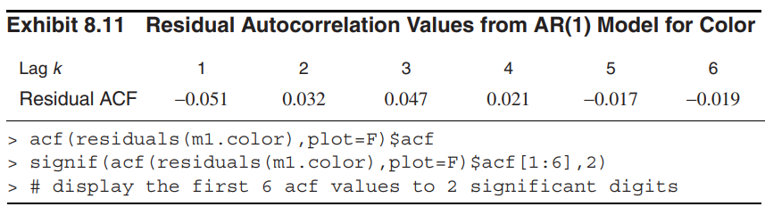
8.1 Residual Analysis
Consider a fitted AR(1) model which generates
Exhibit 8.8, Exhibit 8.11 lists its first 6 autocorrelations of the residuals

Slide 27
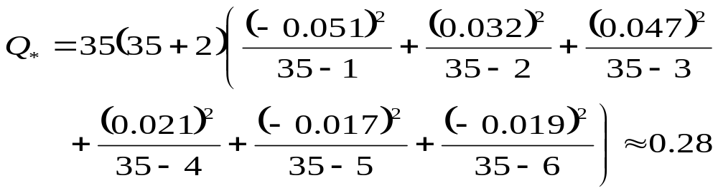
8.1 Residual Analysis
The Ljung-Box test statistic with K = 6 and n = 35 is equal to
This is referred to a chi-square distribution with 6 – 1 = 5 degrees of freedom. This leads to a p-value of 0.998, so we have no evidence to reject the null hypothesis that the error terms are uncorrelated.

Slide 28
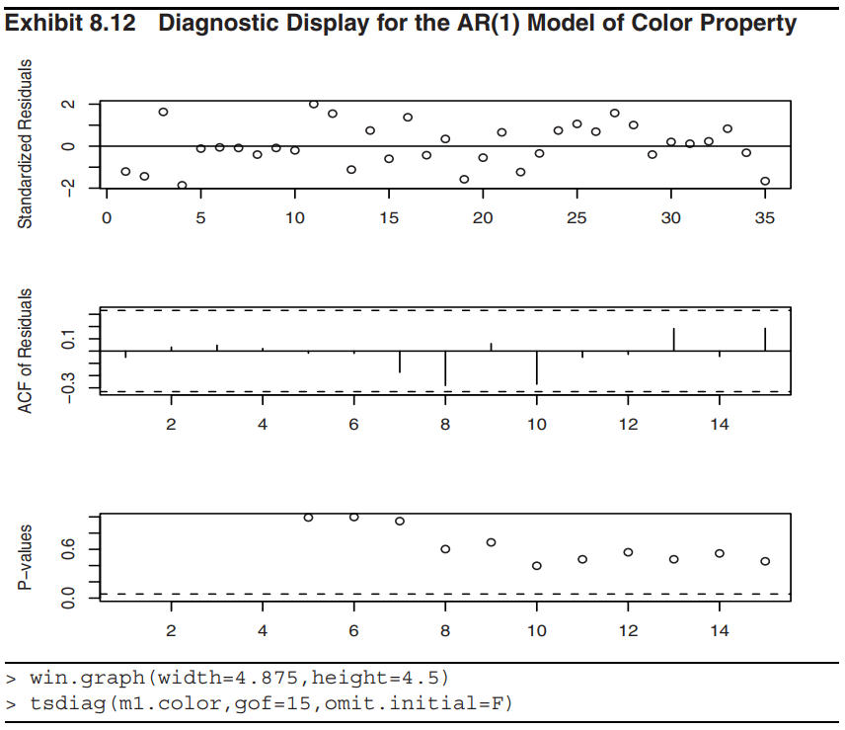

Slide 29
8.1 Residual Analysis
The last diagram in Exhibit 8.12 shows the p-values for the Ljung-Box test statistic for a whole range of values of K from 5 to 15. The horizontal dashed line at 5% helps judge the size of the p-values.
In overall, everything looks very good. The estimated AR(1) model seems to be capturing the dependence structure of the time series very well.

Slide 30
8.2 Overfitting and Parameter Redundancy
After specifying and fitting what we believe to be an adequate model, we fit a slightly more general model; that is, a model “close by” that contains the original model as a special case.

Slide 31
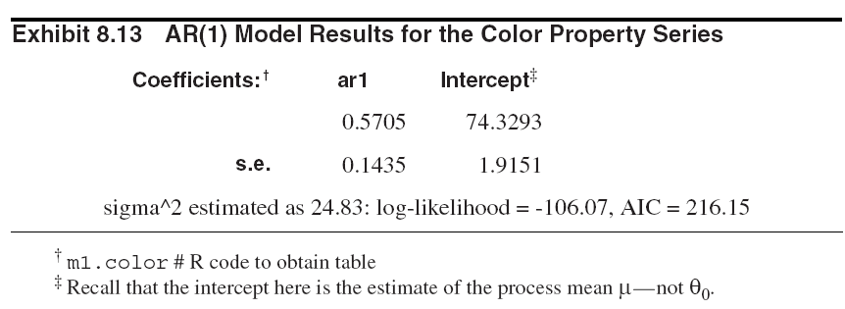
8.2 Overfitting and Parameter Redundancy
Example
Consider the fitted AR(1) model with the output in
Exhibit 8.13

Slide 32
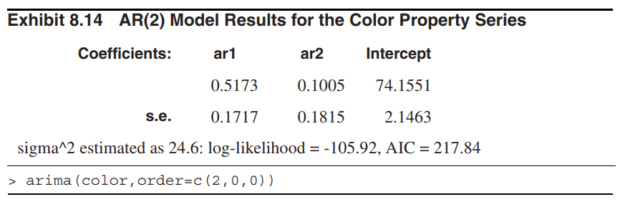
8.2 Overfitting and Parameter Redundancy
Exhibit 8.14 shows the results from fitting an AR(2) model to the same series.

Slide 33
8.2 Overfitting and Parameter Redundancy
Comparing Exhibits 8.13 and 8.14, we have
the estimate of φ₂ is not statistically different from 0.
the two estimates of φ₁ in Exhibits 8.13 and 8.14 are quite close.
While the AR(2) model has a slightly larger log-likelihood value, the AR(1) fit has a smaller AIC value. The penalty for fitting the more complex AR(2) model is sufficient to choose the simpler AR(1) model.

Slide 34
8.2 Overfitting and Parameter Redundancy
As we have noted, any ARMA(p, q) model can be considered as a special case of a more general ARMA model with the additional parameters equal to 0.
However, when generalizing ARMA models, we must aware of the problem of parameter redundancy or lack of identifiability.

Slide 35
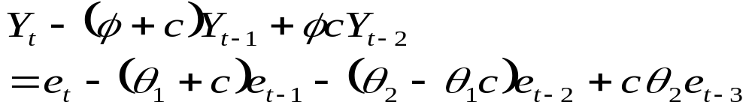
8.2 Overfitting and Parameter Redundancy
Consider an ARMA(1, 2) model:
Now replace t by t – 1 to obtain
If we multiply both sides of Eq (8.2.2) by any constant c and then subtract it from Eq. (8.2.1), we obtain
This apparently defines an ARMA(2, 3) process. But notice that we have the factorizations

Slide 36
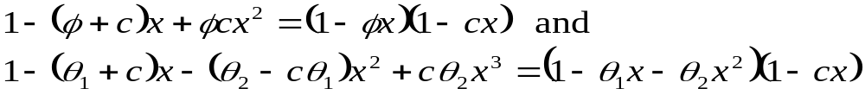
8.2 Overfitting and Parameter Redundancy
Thus the AR and MA characteristic polynomials in the ARMA(2, 3) process have a common factor of (1 – cx).
Even though Y_{t} does satisfy the ARMA(2, 3) model, clearly the parameters in the model are not unique – the constant c is completely arbitrary. We say that we have parameter redundancy in the ARMA(2, 3) model.

Slide 37
8.2 Overfitting and Parameter Redundancy
In backshift notation, if φ(B)Y_{t} = θ(B)e_{t}, then so is
(1 – cB)φ(B)Y_{t} = (1 – cB)θ(B)e_{t} for any constant c. To have unique parameters, we must cancel any common factors in the AR and MA characteristic polynomials.

Slide 38
8.2 Overfitting and Parameter Redundancy
Example
We overfit the last AR(1) model of an ARMA(2, 1) model.
From Exhibit 8.16, we notice that even though the estimate of σ_{e}² and the log-likelihood and AIC values are not too far from their best values, the estimates of φ₁, φ₂, and θ are way off and none would be considered different from zero statistically.

Slide 39
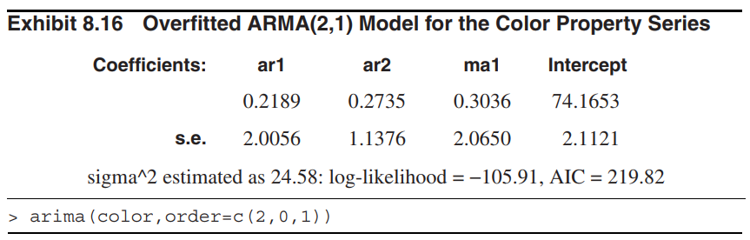
8.2 Overfitting and Parameter Redundancy

Slide 40
8.2 Overfitting and Parameter Redundancy
The implications for fitting and overfitting models are as follows:
Specify the original model carefully. If a simple model seems at all promising, check it out before trying a more complicated model.
When overfitting, do not increase the orders of both the AR and MA parts of the model simultaneously.
Extend the model in directions suggested by the analysis of the residuals. For example, if after fitting an MA(1) model, substantial correlation remains at lag 2 in the residuals, try an MA(2), not an ARMA(1, 1).

Slide 41
Summary
Residual analysis
  If the model is correctly specified and the parameter estimates are reasonably close to the true values, then the residuals should
    have nearly the properties of white noise
    behave roughly like iid normal variables with mean zero and common standard deviations
  Time series plot of standardized residuals
  QQ plot of residuals
  ACF plot of residuals
  Ljung-Box tests

Slide 42
Summary
Usual procedure of diagnostic checking
  Do t-test to drop insignificant coefficients and re-estimate models
  Do portmanteau test (Q*) of residuals
    If more than one model passes t and Q* tests, the model with the smaller AIC/BIC value can be selected
    If no model passes both t and Q* tests, revise model and redo the estimation and diagnostic checking (revision of models can be inferred from ACF/PACF plots of residuals)

Slide 43
Summary
Overfitting and parameter redundancy
  Overfitting may cause the problem of parameter redundancy or lack of identifiability.
  When overfitting, do not increase the orders of both the AR and MA parts of the model simultaneously.
  A simple adequate model is preferred.

